Slide 1
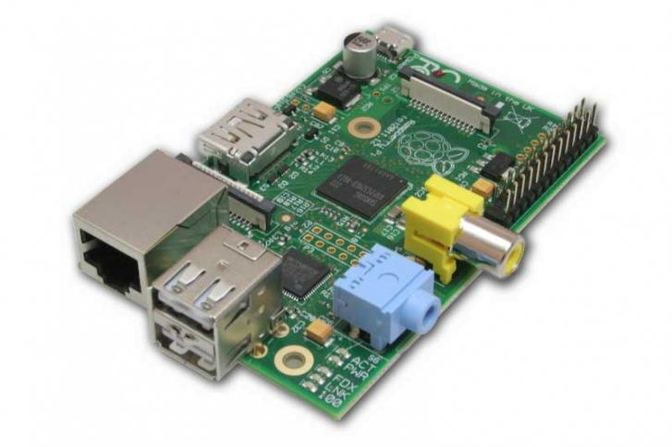
Raspberry Pi – GPIO

Slide 2
Raspberry Pi – GPIO
26 pin connector

Slide 3
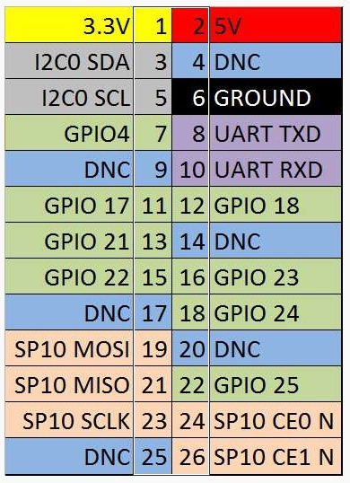
Raspberry Pi – GPIO
PIN-OUT
8 free digital I/O

Slide 4
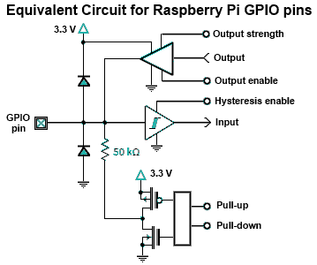
Raspberry Pi – GPIO

Slide 5
Raspberry Pi – GPIO
Some I/O Electrical Parameters
V_{IL} | Input low voltage | Typical: < 0,54V
V_{IH} | Input high voltage | Typical: > 2,31V
V_{OL} | Output low voltage | Typical: < 0,40V
V_{OH} | Output high voltage | Typical: > 2,40V
I_{DRV} | Intensity drive (single pin) Sink/Source | 2 - 16 mA (2mA step select) Typical: 8mA
I_{DRV} | Intensity drive (all pins) | Maximum: 50mA !!
R_{UD} | Pull Up/down resistor | Typical: 50 KOhm

Slide 6
Raspberry Pi – GPIO
PYTHON CODE EXAMPLE
provaio.py
import RPi.GPIO as GPIO
GPIO.setmode(GPIO.BCM)
GPIO.setup(23,GPIO.IN,pull_up_down=GPIO.PUD_UP)
print("Esperant contacte...")
GPIO.wait_for_edge(23,GPIO.FALLING)
print("Sortint")
GPIO.cleanup()

Slide 7
Raspberry Pi – GPIO
PYTHON CODE EXAMPLE
Prerequisites:
>sudo apt-get update
>sudo apt-get install python-dev
>sudo apt-get install python-rpi.gpio

Slide 8
Raspberry Pi – GPIO
TEST: GPIO23 (pin 16) connects to GROUND (pin 6)

